Slide 1
Topic = Malignant Commentes Classifier - Multi Label Classification Project
[ Name: Saunak Mukherjee] [Institution: DataTrained] [Flip Robo Technology]

Slide 2
Problem Statement
Our aim is to build a prototype of online hate and abuse comment classifier which can be use for classify hate and offensive comments so that it can be controlled and restricted from spreading hatred and cyberbullying.

Slide 3
Problem Statement
The proliferation of social media enables people to express their opinions widely online. However, at the same time, this has resulted in the emergence of conflict and hate, making online environments uninviting for users. Although researchers have found that hate is a problem across multiple platforms, there is a lack of models for online hate detection.
Online hate, described as abusive language, aggression, cyberbullying, hatefulness and many others has been identified as a major threat on online social media platforms. Social media platforms are the most prominent grounds for such toxic behaviour.
There has been a remarkable increase in the cases of cyberbullying and trolls on various social media platforms. Many celebrities and influences are facing backlashes from people and have to come across hateful and offensive comments. This can take a toll on anyone and affect them mentally leading to depression, mental illness, self-hatred and suicidal thoughts.
Internet comments are bastions of hatred and vitriol. While online anonymity has provided a new outlet for aggression and hate speech, machine learning can be used to fight it. The problem we sought to solve was the tagging of internet comments that are aggressive towards other users. This means that insults to third parties such as celebrities will be tagged as unoffensive, but “u are an idiot” is clearly offensive.
Our goal is to build a prototype of online hate and abuse comment classifier which can used to classify hate and offensive comments so that it can be controlled and restricted from spreading hatred and cyberbullying.

Slide 4
Overview
The data set contains the training set, which has approximately 1,59,000 samples and the test set which contains nearly 1,53,000 samples. All the data samples contain 8 fields which includes ‘Id’, ‘Comments’, ‘Malignant’, ‘Highly malignant’, ‘Rude’, ‘Threat’, ‘Abuse’ and ‘Loathe’.
The label can be either 0 or 1, where 0 denotes a NO while 1 denotes a YES. There are various comments which have multiple labels. The first attribute is a unique ID associated with each comment.
The data set includes:
Malignant: It is the Label column, which includes values 0 and 1, denoting if the comment is malignant or not.
Highly Malignant: It denotes comments that are highly malignant and hurtful.
Rude: It denotes comments that are very rude and offensive.
Threat: It contains indication of the comments that are giving any threat to someone.
Abuse: It is for comments that are abusive in nature.
Loathe: It describes the comments which are hateful and loathing in nature.
ID: It includes unique Ids associated with each comment text given.
Comment text: This column contains the comments extracted from various social media platforms.
This project is more about exploration, feature engineering and classification that can be done on this data. Since the data set is huge and includes many categories of comments, we can do good amount of data exploration and derive some interesting features using the comments text column available.
You need to build a model that can differentiate between comments and its categories.
Refer to the data set file provided along with this.

Slide 5
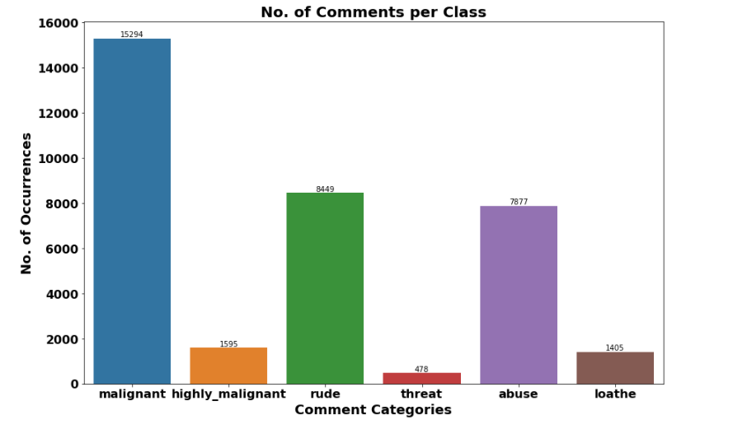
Target Variable Ratings
We have seen around 90% comments are good and 10% are nagetive.

Slide 6
Interesting Facts
We have seen there are around 43.58% are malignant in nature followed by 24.07% are rude comments

Slide 7
The Majority of the comments are of length 500, where maximum length is 5000 and minimum length is 5. Median length being 250.

Slide 8
Word Cloud
Word Cloud which is the visualization technique for text data where we can use each word that is picturized with its importance of the context or its frequency.
The more commonly which is the term of appears within the text being with analysed, the larger the word appears in the image which is generated.
The enlarged texts that are the greatest number of the words used for the and small texts which are the smaller number of the words used.

Slide 9
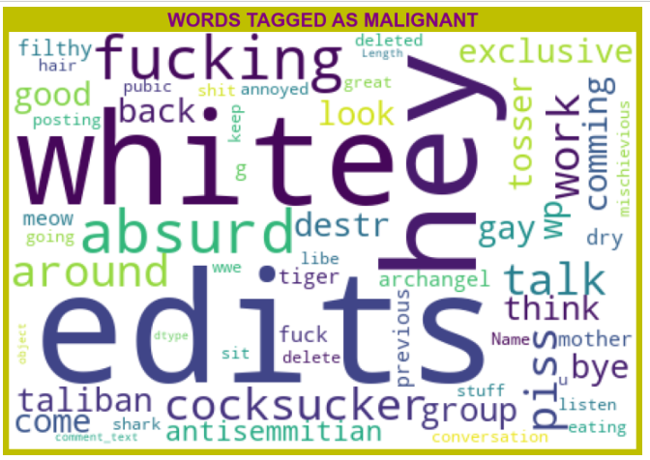
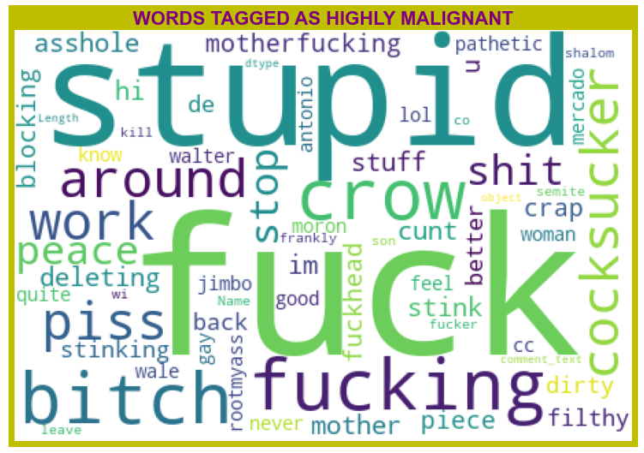
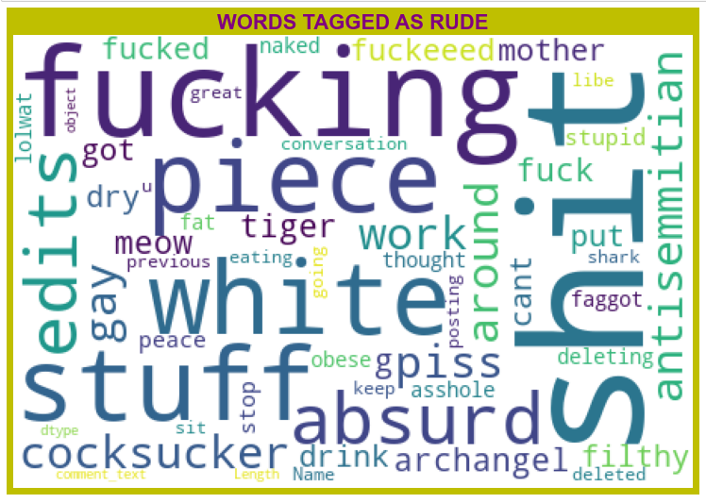
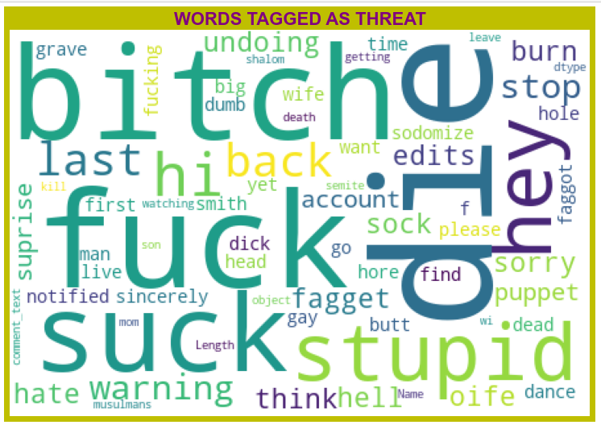
Word Cloud
From word cloud of Rude comments, it is clear that it mostly consists of words like fucking, shit, white, piece, stupid,die,gay, stuff, absurd etc

Slide 10
Machine Learning Model Building
We are using this classifier Random Forest classifier,Support Vector Classifier,Logistics Regression,AdaBoost Classifier.

Slide 11
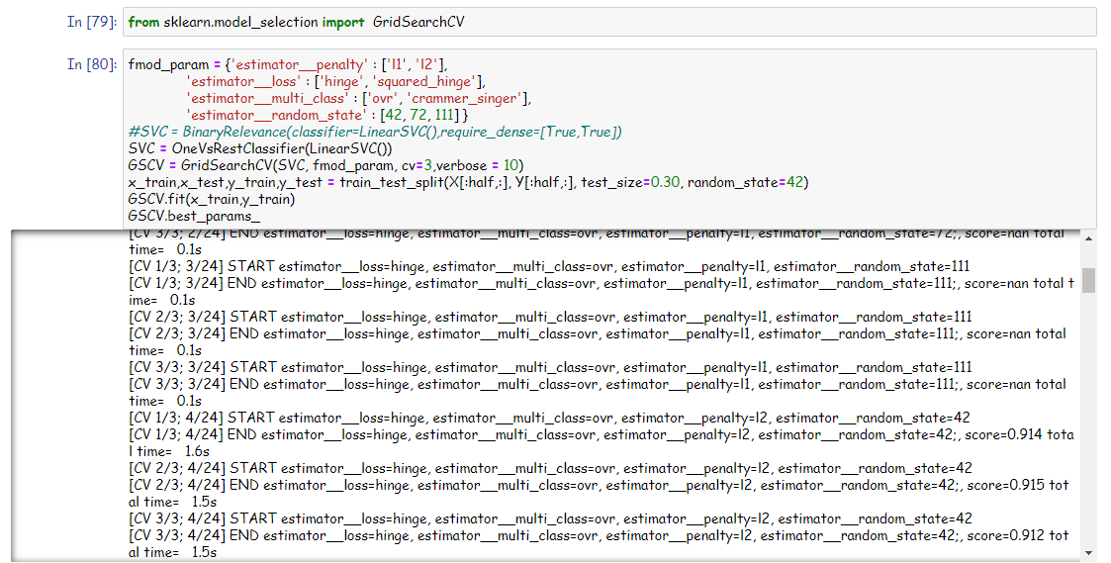
Hyper parameter Tuning
Hyper parameter Tuning is perform over this best model using best param shown below :

Slide 12
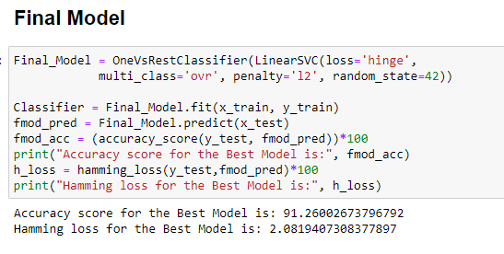
Resources
Final Model which is giving us Accuracy score of 91.26%.

Slide 13
CONCLUSION
Hyperparameter Tuning which is giving us Accuracy score of 91.26% which is slightly improved compare to earlier Accuracy score of 91.15%.

